Slide 1
Discrete Random Variables

Slide 2
Outline
Definition of a Random Variable (RV)
Discrete Random Variables
Examples of Discrete RV
Bernoulli
Binomial
Poisson
Geometric
Expectations, Variances

Slide 3
Definition of a Random Variable
A random variable is a real valued function defined on a sample space S. In a particular experiment, a random variable X would be some function that assigns a real number X(s) for each possible outcome
A discrete random variable can take a countable number of values.
Number of steps to the top of the Eiffel Tower*
A continuous random variable can take any value along a given interval of a number line.
The time a tourist stays at the top
once s/he gets there
Notes:
A random variable is a variable that assumes numerical values associated with the random outcome of an experiment, where one (and only one) numerical value is assigned to each sample point.

Slide 4
Probability Distributions, Mean and Variance for Discrete Random Variables
The probability distribution of a discrete random variable is defined as a function that specifies the probability associated with each possible outcome the random variable can assume.
p(x) ≥ 0 for all values of x
Σp(x) = 1
The mean, or expected value, of a discrete random variable is
The variance of a discrete random variable x is

Slide 5


Slide 6
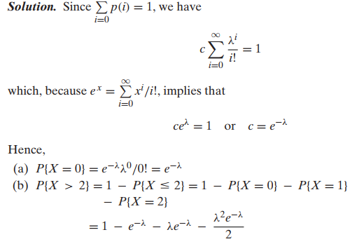

Slide 7


CDF

Slide 8
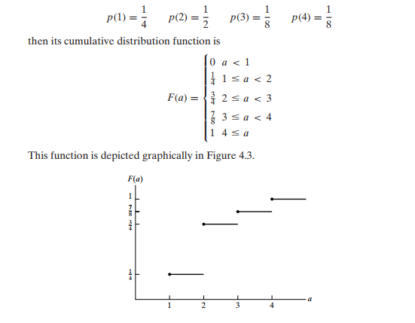

Slide 9
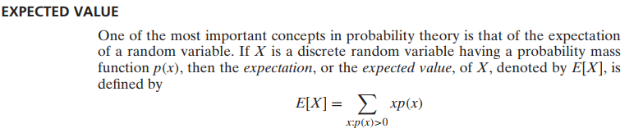
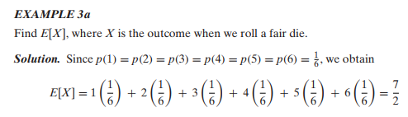
weighted average of the possible values of X

Slide 10
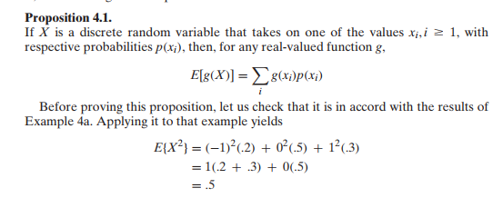

Slide 11
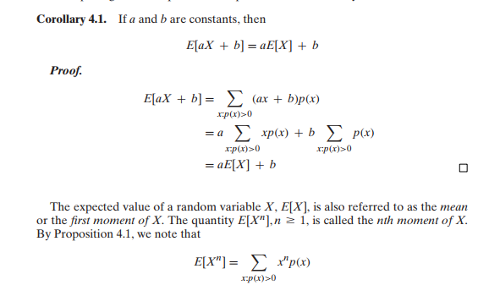

Slide 12
Variance
Given a random variable X along with its distribution function F, it would be extremely useful if we were able to summarize the essential properties of F by certain suitably defined measures.
One such measure would be E[X], the expected value of X.
However, although E[X] yields the weighted average of the possible values of X, it does not tell us anything about the variation, or spread, of these values.

Slide 13
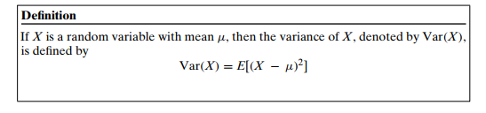


Slide 14
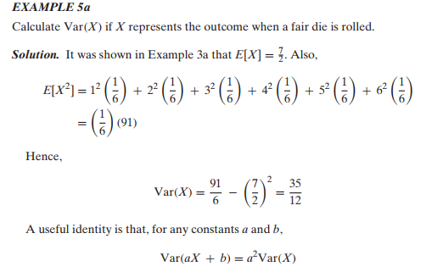

Slide 15
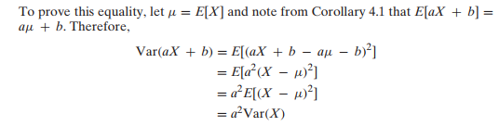


Slide 16

The Binomial Distribution
A Binomial Random Variable
n identical trials
Two outcomes: Success or Failure
P(S) = p; P(F) = q = 1 – p
Trials are independent
x is the number of S’s in n trials
Flip a coin 3 times
Outcomes are Heads or Tails
P(H) = .5; P(F) = 1-.5 = .5
A head on flip i doesn’t change P(H) of flip i + 1

Slide 17
The Binomial Distribution (Example 1)
Results of 3 flips | Probability | Combined | Summary
HHH | (p)(p)(p) | p³ | (1)p³q⁰
HHT | (p)(p)(q) | p²q
HTH | (p)(q)(p) | p²q | (3)p²q¹
THH | (q)(p)(p) | p²q
HTT | (p)(q)(q) | pq²
THT | (q)(p)(q) | pq² | (3)p¹q²
TTH | (q)(q)(p) | pq²
TTT | (q)(q)(q) | q³ | (1)p⁰q³

Slide 18
The Binomial Distribution Probability Distribution
The probability of getting the required number of successes
The probability of getting the required number of failures
The number of ways of getting the desired results
Find the mean and variance of Binomial RV

Slide 19
The Binomial Distribution Probability Distribution
Example 2: Say 40% of the class is female.
What is the probability that 6 of the first 10 students walking in will be female?

Slide 20
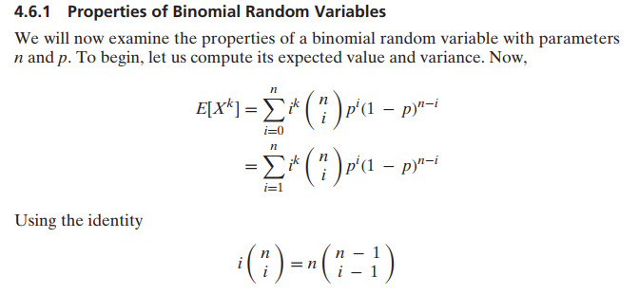

Slide 21
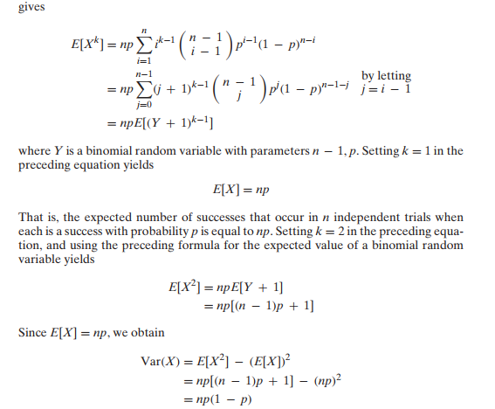

Slide 22
Mean and Variance of Binomial Distribution

Slide 23
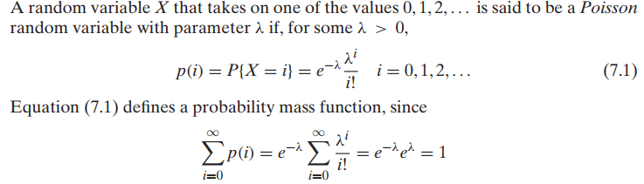
Poisson Random Variable

Slide 24
The Poisson random variable has a tremendous range of applications in diverse areas because it may be used as an approximation for a binomial random variable with parameters (n, p)
when n is large and p is small enough so that np is of moderate
Prove it!

Slide 25
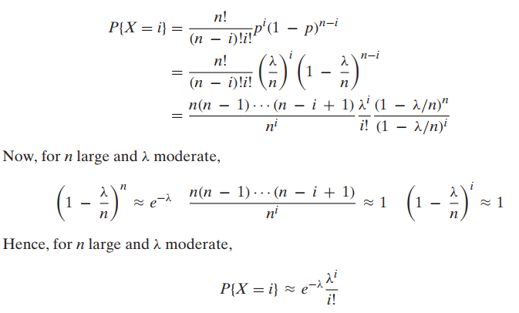

Slide 26
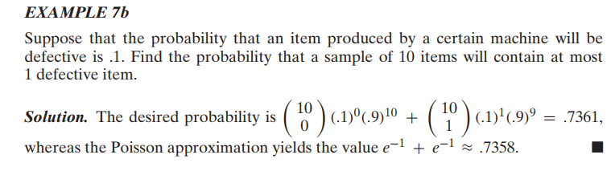

Slide 27
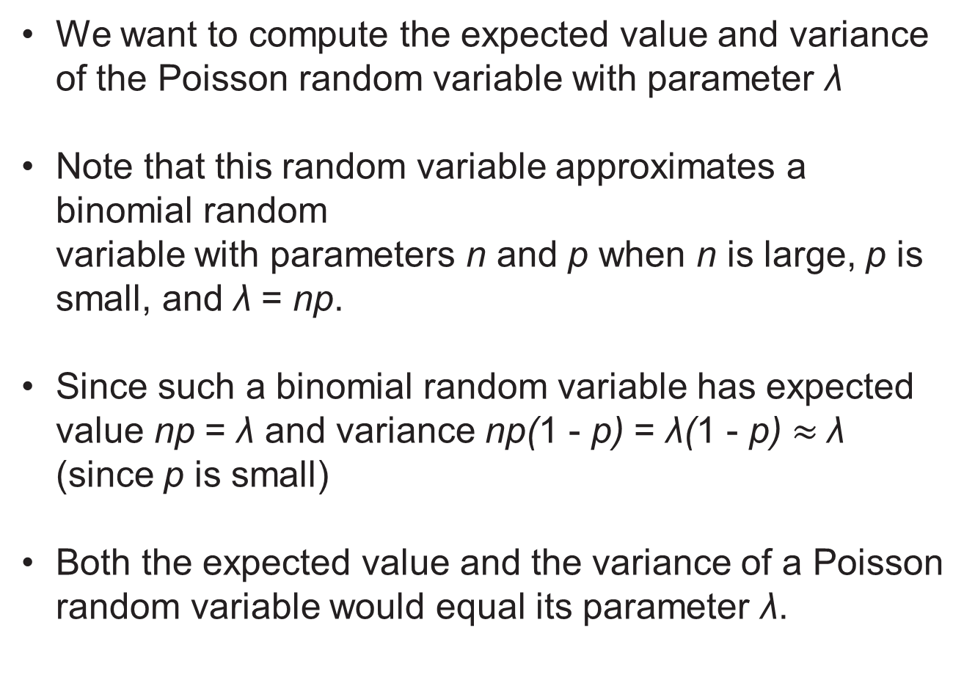
Poisson RV (Mean and Variance)
We want to compute the expected value and variance of the Poisson random variable with parameter λ
Note that this random variable approximates a binomial random variable with parameters n and p when n is large, p is small, and λ = np.
Since such a binomial random variable has expected value np = λ and variance np(1 - p) = λ(1 - p) $≈$λ (since p is small)
Both the expected value and the variance of a Poisson random variable would equal its parameter λ.

Slide 28
Proof for mean

Slide 29
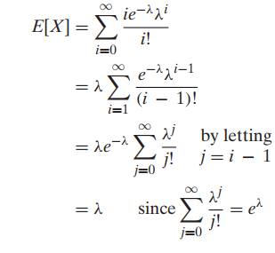

Slide 31
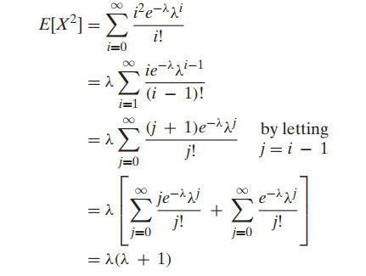


Slide 32


Geometric RV

Slide 33
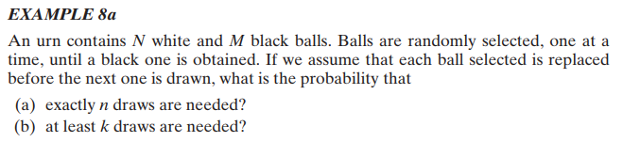

Slide 34
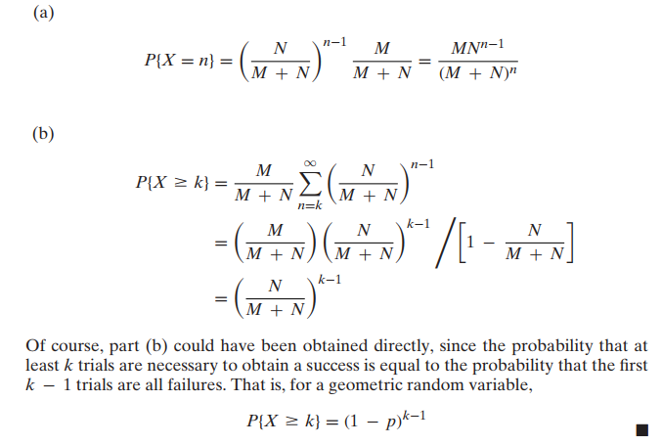

Slide 35


Mean and Variance of Geometric RV

